Slide 1
Natural Disasters

Slide 2
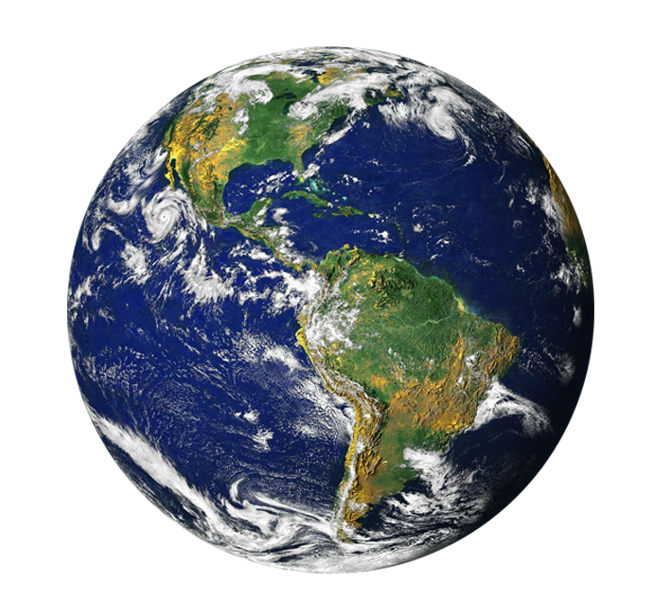
Global Problems
Every year there are big and small disasters in different parts of the world.

Slide 3
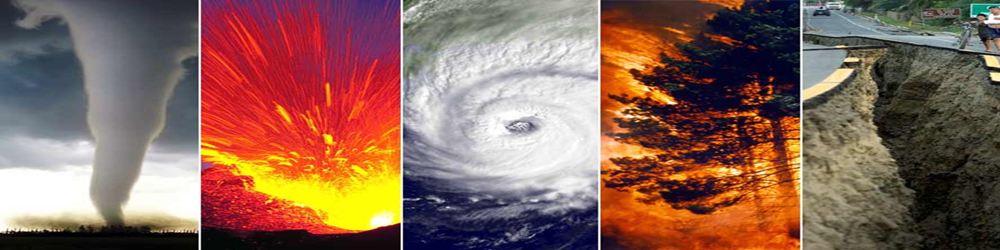
Disasters
There are many nature disasters in the world, for explain: droughts, volcano eruptions, forest fires, earthquakes, tornados, etc.

Slide 4

Ways to predict Natural Disasters
We can learn from them and use this knowledge to live safely on our planet.

Slide 5
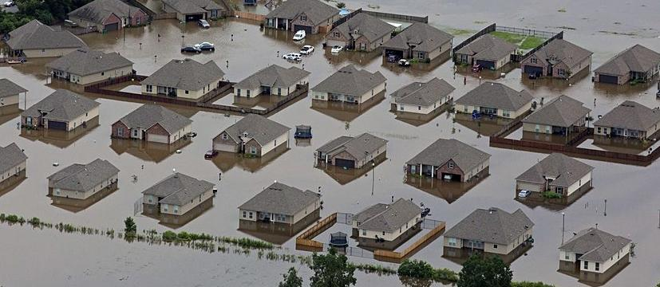
Floods
To prevent floods we should stop deforestation, build dumbs or artificial lakes.

Slide 6
If we want to prevent
Landslides – plant more trees on the hill slides
Tidal waves – build breakwaters
Problems of the pollution - find alternative source of the energy

Slide 7
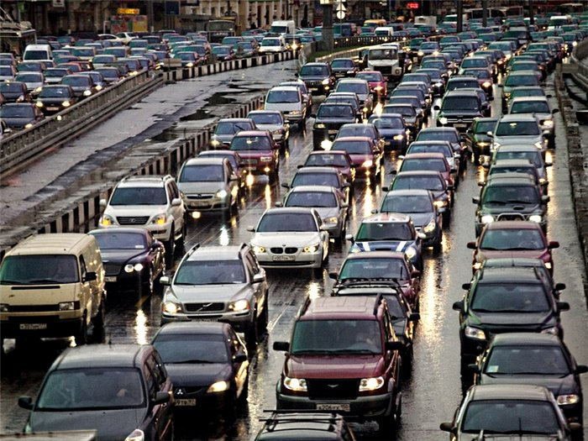
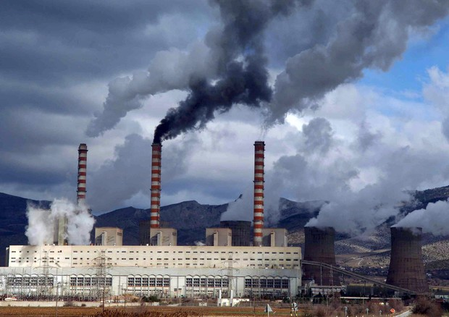
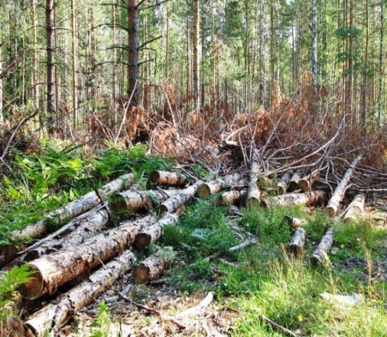
We must stop
The number of the cars
Dumping chemical wastes
Cutting forests
It is necessary
to reduce and stop

Slide 8

Conclusion
We must be merciful to the other people and our planet – the Earth.

